Slide 1


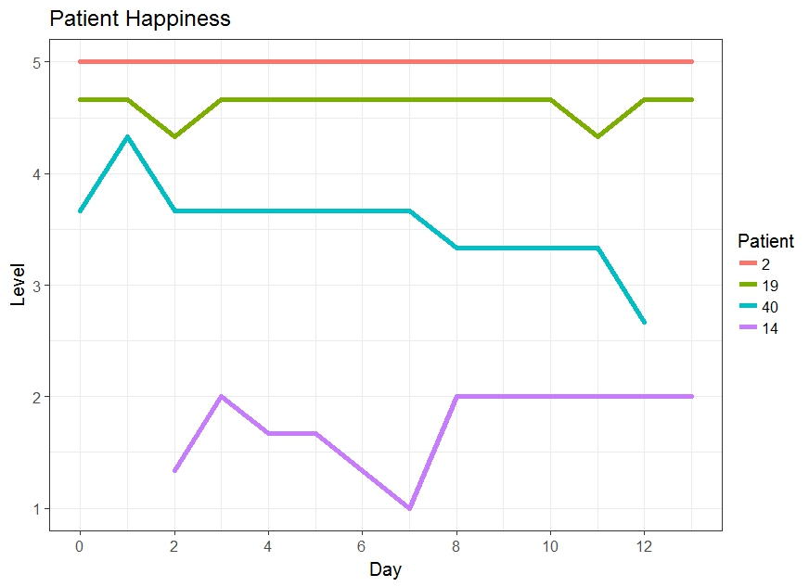

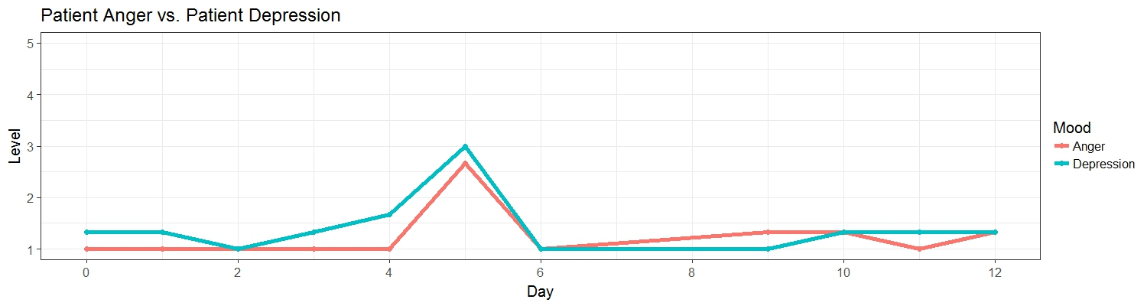
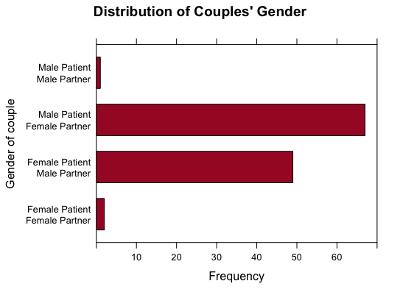
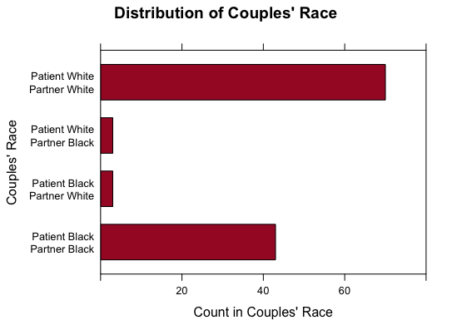
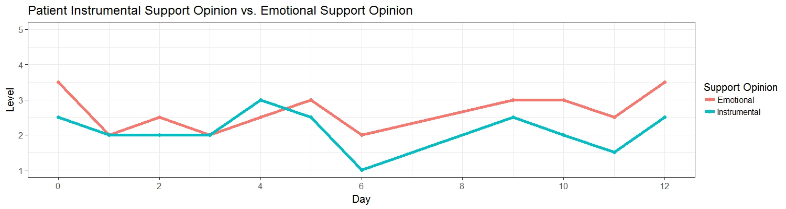
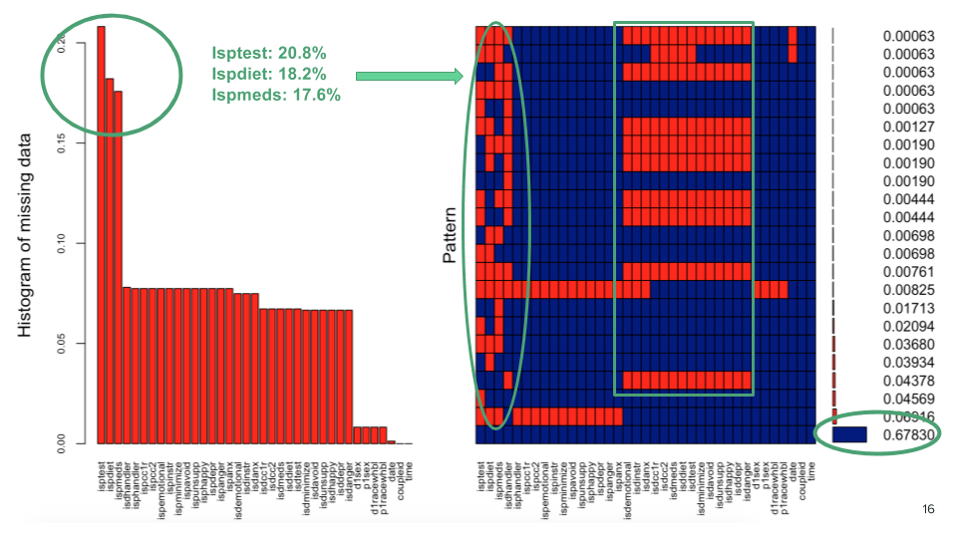
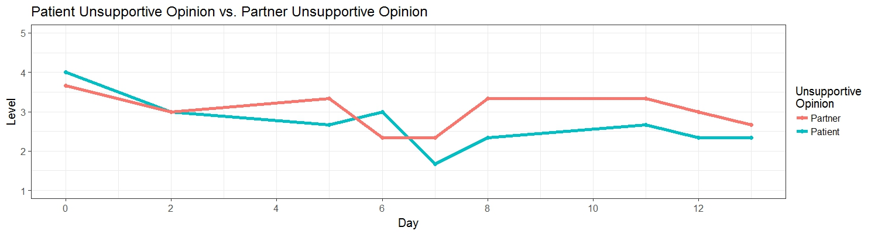
Does Communal Coping Affect Diabetes Treatment?
Dr. Vicki Helgeson¹, Dr. Howard Seltman², Andersen Chang², Mengran He²
¹Carnegie Mellon University, Department of Psychology; ²Carnegie Mellon University, Department of Statistics
36-726 Statistical Practice
Factor Analysis
Exploratory analysis to investigate variable relationships.
Factors capture a certain amount of variability in observed variables.
Loadings explain relationship of each variable to unobserved factor.
Modeling
Introduction
Type II Diabetes
Pervasive chronic disease caused by insulin resistance.
Commonly associated with other negative health effects.
Treated through self-care habits: exercise, diet, medication.
Treatment adherence and/or effectiveness might be affected by social environment.
Communal Coping
Cooperative problem solving process for dealing with individual and collective stressors.
Appraisal of problem as joint.
Collaboration to address problem.
In context: romantic partner’s contribution to patient treatment.
Modeling
Mixture Models
Hierarchical structure in data: repeated observations of couple
Possible correlation of observations across time.
Different “base” levels per couple.
Loadings | Factor 1 | Factor 2 | Factor 3 | Factor 4 | Factor 5 | Factor 6
Patient: Happy? | -0.56
Patient: Depressed? | 0.87
Patient: Angry? | 0.80
Patient: Anxious? | 0.67
Partner: Happy? |  | -0.53
Partner: Depressed? |  | 0.90
Partner: Angry? |  | 0.78
Partner: Anxious? |  | 0.62
Patient: Emotional Support? |  |  | 0.66 | 0.35
Patient: Instrumental Support? |  |  | 0.85
Partner: Emotional Support? |  |  |  | 0.80
Patient: Minimized |  |  | 0.35 |  | 0.58
Partner: Minimized |  |  |  |  | 0.64
Partner: Feel unsupportive? |  |  |  |  |  | 0.65
Partner: Instrumental Support? |  |  |  | 0.48 | 0.40
Patient: Avoidant?
Partner: Avoidant? |  |  |  |  |  | 0.39
Patient: Feel unsupportive? | 0.30 |  |  |  |  | 0.35
Proportion Variance | 0.13 | 0.12 | 0.08 | 0.07 | 0.06 | 0.05
Cumulative Variance | 0.13 | 0.26 | 0.34 | 0.40 | 0.47 | 0.52
Possible hierarchical structure in data.
Research Questions
1) How does communal coping affect psychological outcomes for patient and partner?
2) Are effects different based on race or gender?
3) Is there a combination of communal coping sentiments that works best?
.
Fixed effects: communal coping sentiments & behaviors
Interactions: gender, race.
Random effects: intercept & slope for time with respect to couple
Autoregressive correlation between residuals
Data
Dates of Entry: 2012 – 2015
119 couples, recruited from local Pittsburgh communities.
One member diagnosed with diabetes within 3 years prior.
Daily iPad surveys completed separately over two weeks.
Self-evaluations of moods/emotions, treatment adherence, supportive behavior, communal coping.
1333 completed entries out of 1666 possible.
Note: Blank cell means that absolute value of loading is less than 0.30.
With 6 factors, 52% of variance explained
Factors show expected relationships between mood variables:
Factors 1 and 2: Patient’s and partner’s answers about moods are strongly associated.
Factors 3 and 4: Opinions about emotional support and instrumental support are correlated.
Conclusion
Results/Discussion
Negative emotions are correlated with unsupportive sentiments.
Answers about support functions (emotional, instrumental, and informational) are associated with each other.
Couple’s answers on the daily report are correlated over time.
What would we see from longer time spans?
Are survey answers reliable?
Near-Future Work
Use model selection to fit mixture models for all response variables.
Create multivariate mixture models.
Further analyze general effects of communal coping on outcomes.
Examine differences based on demographics (race, gender).
Factors 5 and 6: Correlation between opinions about unsupportive interactions.
Missing Values: Either patient or partner filled out daily survey, but the other one didn't.
Reference: Helgeson, V. S., Mascatelli, K., Seltman, H., Korytkowski, M., & Hausmann, L. R. (2016). Implications of supportive and unsupportive behavior for couples with newly diagnosed diabetes. Health Psychology,35(10), 1047-1058. doi:10.1037/hea0000388

